Slide 1

Expand course4-Chameleon
Yahboom
Yahboom OMIBOX Tutorial

Slide 2
1
2
3
4
5
Learning
goals
Search for
blocks
Combine
blocks
Experimental
phenomena
Preparation
程序编程
Tencent
Yahboom OMIBOX Tutorial

Slide 3
1
Preparation-1
1. The position of the RGB lights and color detection module in the robot car
2. Learn how to use RGB lights and identify graphically program building blocks
Yahboom OMIBOX Tutorial

Slide 4
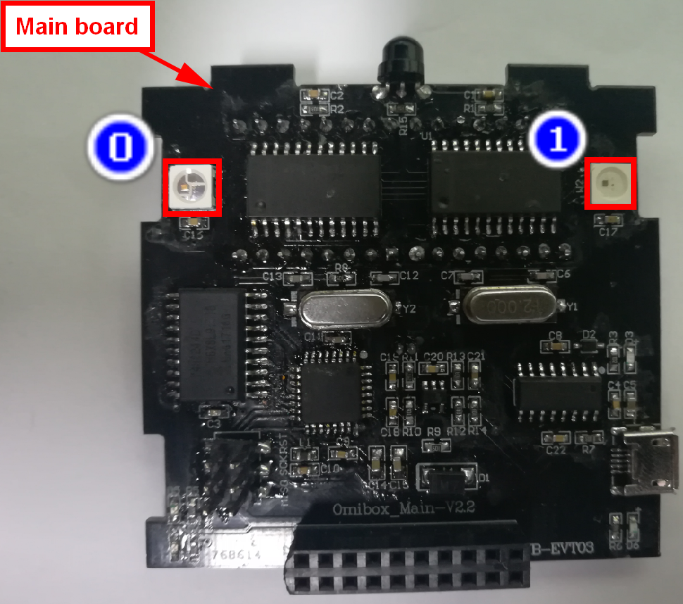
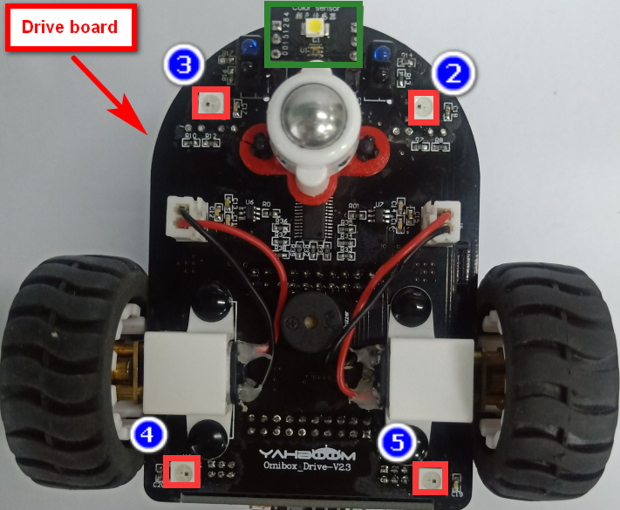
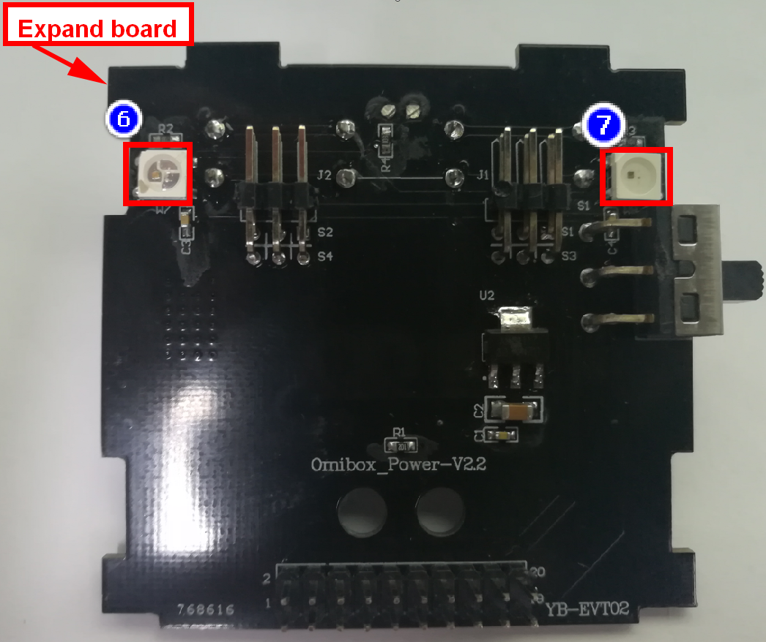
1
Preparation-2
As shown in the above picture, we circled RGB lights with a red wire frame,we circled the color detection module with a green wire frame.
Yahboom OMIBOX Tutorial

Slide 5
2
Learning goals
In this lesson, we will learn how to realize RGB lights are lighted up the corresponding color when the Omibox robot recognizes different colors.
Yahboom OMIBOX Tutorial

Slide 6
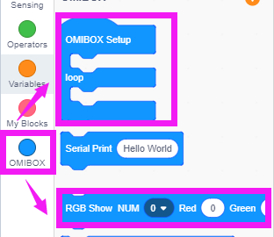
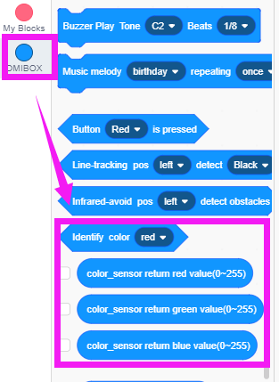
3
Search for blocks
The following is the location of the building blocks required for this programming.
Yahboom OMIBOX Tutorial

Slide 7
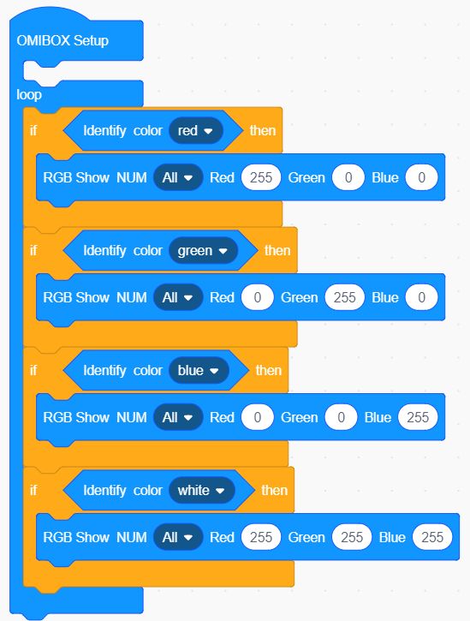
4
Combine blocks
The summary program is shown below:
Method1：
Yahboom OMIBOX Tutorial

Slide 8
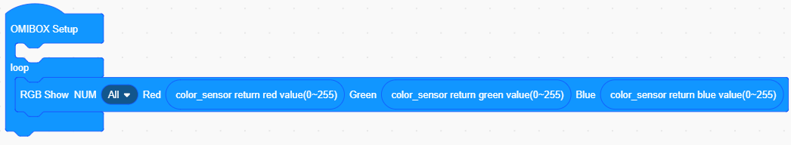
4
Combine blocks
Method2：
Yahboom OMIBOX Tutorial

Slide 9
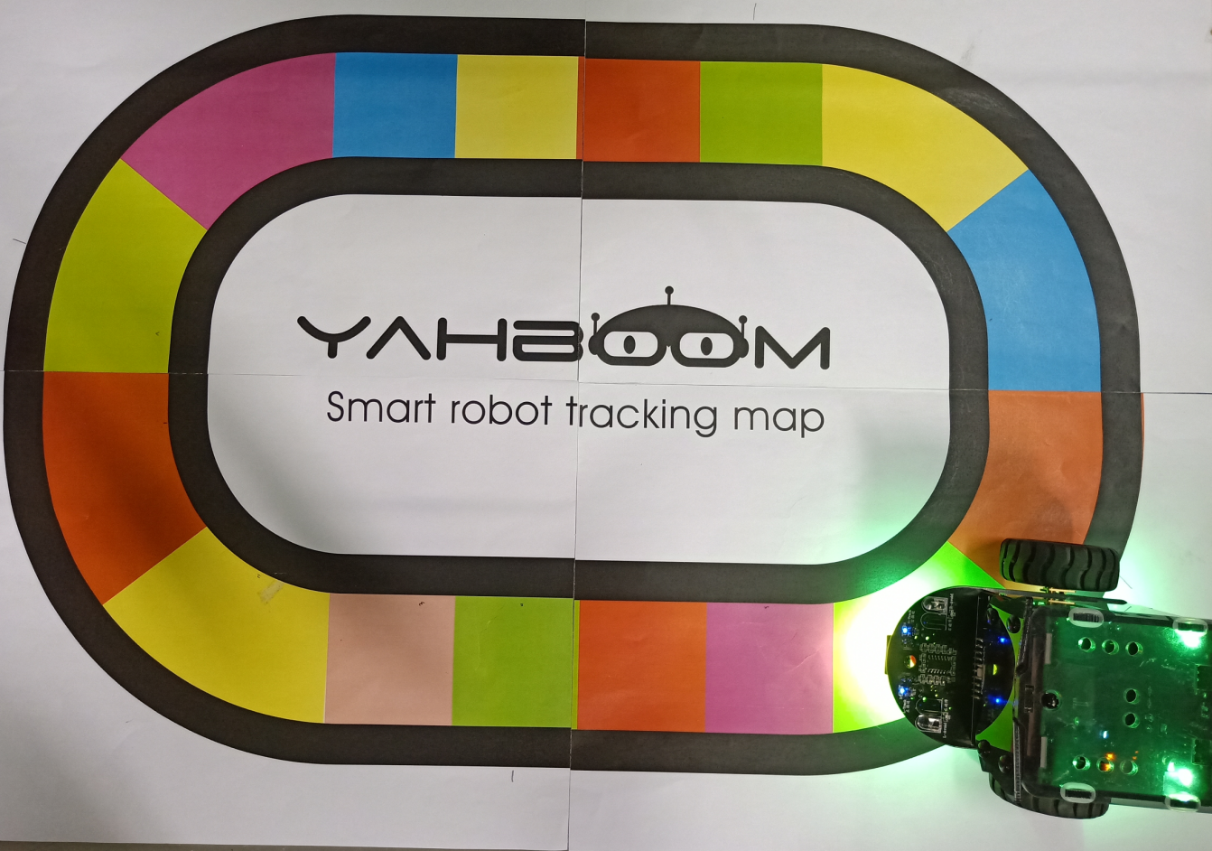
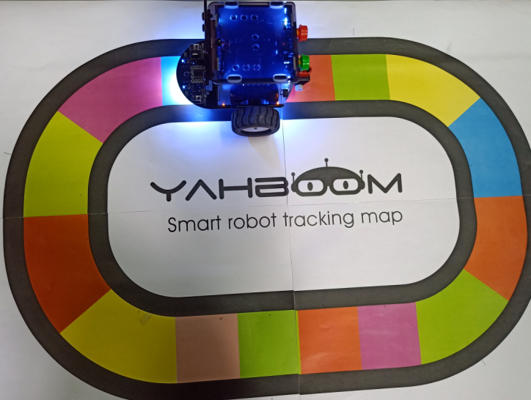
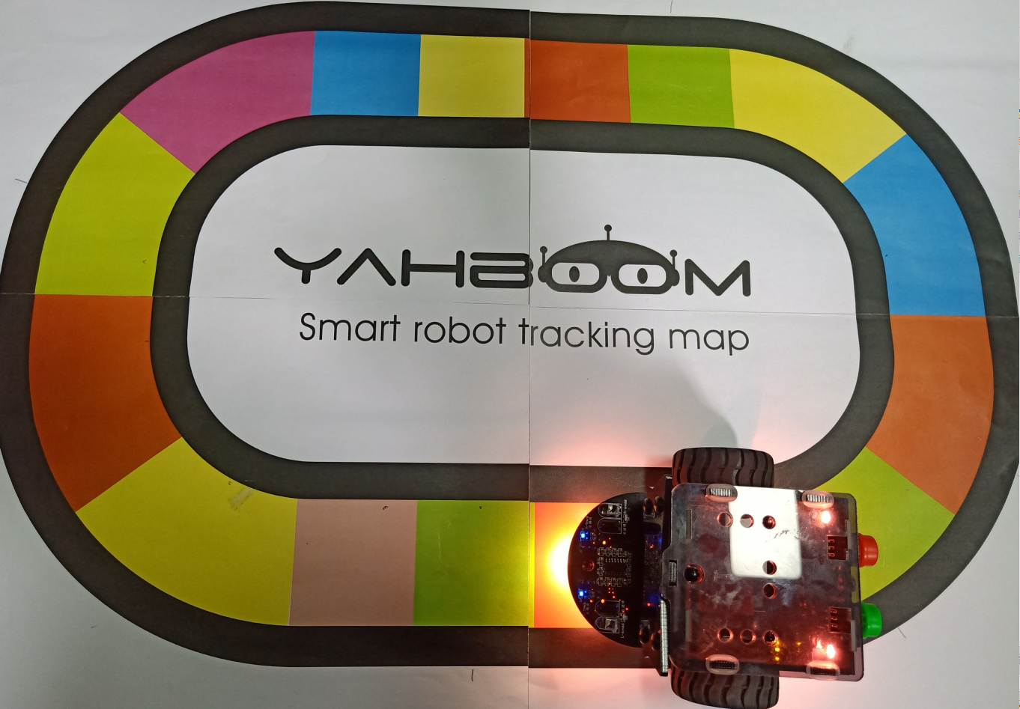
5
Experimental phenomena
After the program is uploaded, open the power of the car. The RGB lights will change color when it detects different colors.
Yahboom OMIBOX Tutorial

Slide 10
Inspire Creativity Embrace Innovation
Thank you!!!
Yahboom

